Slide 1

EMPLOYABILITY SKILLS
OF THE FUTURE

Slide 2
EMPLOYABILITY SKILLS
Problem-solving and reasoning
Computer operation
High-level reading, math, & communications
Occupational proficiency
Ability to work as a team member
Ability to make decisions
Adapt to change
Notes:
5
5

Slide 3
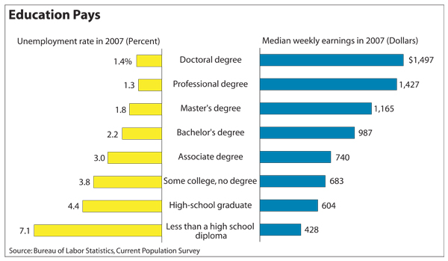
Education pays in higher earnings and lower unemployment rates

Slide 4
How many years will you work?
Most people graduate high school around the age of 18.
People born after 1960 can not retire with full social security benefits until the age of 67. (This is you!)
Therefore 67-18 = 49 years to work in the future.
Your cheery thought for the day is that you will have to work four times longer than you have been alive so far.
How do you feel about that?

Slide 5
If you add more education, how long will you have to work?
18 plus two years of technical training = age 20
67-20 = 47 years to work
18 plus four years of college= age 22 (if you complete a four year degree in four years)
67-22= 45 years to work
Imagine having a job that you don’t like for the next 49, 47 or 45 years.

Slide 6


I’ll make enough without high school.
Minimum wage moved to $7.25 on July 24, 2009.
No one can support themselves on $7.25 per hour let alone a family.
There are more minimum wage earners in the south than any other part of the country.

Slide 7
What would I make at minimum wage over my lifetime?
$7.25 per hour
X 40 hours per week
X 52 weeks per year
______________ annual amount
X 49 years (graduate at 18 and retire with social security at 67)
_______________ = total lifetime earnings

Slide 8
What would I make at minimum wage over my lifetime?
$7.25 per hour
X 40 hours per week
X 52 weeks per year
__$15,080.00__ annual amount
X 49 years (graduate at 18 and retire with social security at 67)
__$738,920.00___ = total lifetime earnings

Slide 9
What would I make at a skilled laborer’s wage over my lifetime?
$15.00 per hour for skilled laborers
X 40 hours per week
_$_____________
X 52 weeks per year
_$_____________ annual amount
X 47 years (graduate at 18, go to two years of technical school and retire with social security at 67)
__$______________ = total lifetime earnings

Slide 10
What would I make at a skilled laborer’s wage over my lifetime?
$15.00 per hour for skilled laborers
X 40 hours per week
X 52 weeks per year
_$31,200.00__ annual amount
X 47 years (graduate at 18, go to two years of technical school and retire with social security at 67)
__$1,466,400.00___ = total lifetime earnings

Slide 11
What are some high skilled jobs in Georgia?
Ga Jobs and Growth Projections
Georgia New Emerging Industries
http://www.careeroverview.com/professional-careers.html

Slide 12
What would I make in a professional position over my lifetime?
$30.00 per hour
X 40 hours per week
_$_________________
X 52 weeks per year
__$______________per year or annual amount
X 45 years (graduate at 18 then go to four years of college and retire with social security at 67)
__$_____________ total lifetime earnings

Slide 13
What would I make in a professional position over my lifetime?
$30.00 per hour
X 40 hours per week
X 52 weeks per year
__$62,400.00___ annual amount
X 45 years (graduate at 18 then go to four years of college and retire with social security at 67)
__$2,808,000.00___ = total lifetime earnings

Slide 14
What are some professional jobs in Georgia?
http://www.bls.gov/oco/oco1002.htm
Middle Income http://swz.salary.com/salarywizard/layouthtmls/swzl_salaryrangenarrow_20.html

Slide 15
What did you think?
Is there a difference in the education level for non-skilled and skilled laborers?
What changes do you need to make at this time to get the education and training for a skilled position?
You also need to keep in mind that when working in a position that your really enjoy you may work longer before you retire too.

Slide 16
Does that “good job” still look wonderful?
How many hours per week would a minimum wage worker have to work to make the same as a skilled laborer?
How many hours per week would a minimum wage worker have to work to make the same a as a professional?
Would or could you really put in the hours to make the same amount as an educated person?

Slide 17
Is it possible?
With 24 hours in a day
7 days in a week
With those hours per week you’re not going to see much of your family or time to get any sleep.
And in most cases, forget paid vacations and insurance benefits.

Slide 18
In conclusion…
The importance of an education can not be neglected by anyone.
In today’s world, the role of education has become even more vital.
It is an absolute necessity for economic and social development of any nation.
It is vital for the success of anyone.

Slide 19
Additional reference sources
America’s Career Resource Network (ACRN)
GACollege411
Georgia Department of Labor
Occupation Supply and Demand
Bureau of Statistics
http://swz.salary.com/salarywizard/layouthtmls/swzl_salaryrangenarrow_20.html

